Slide 1
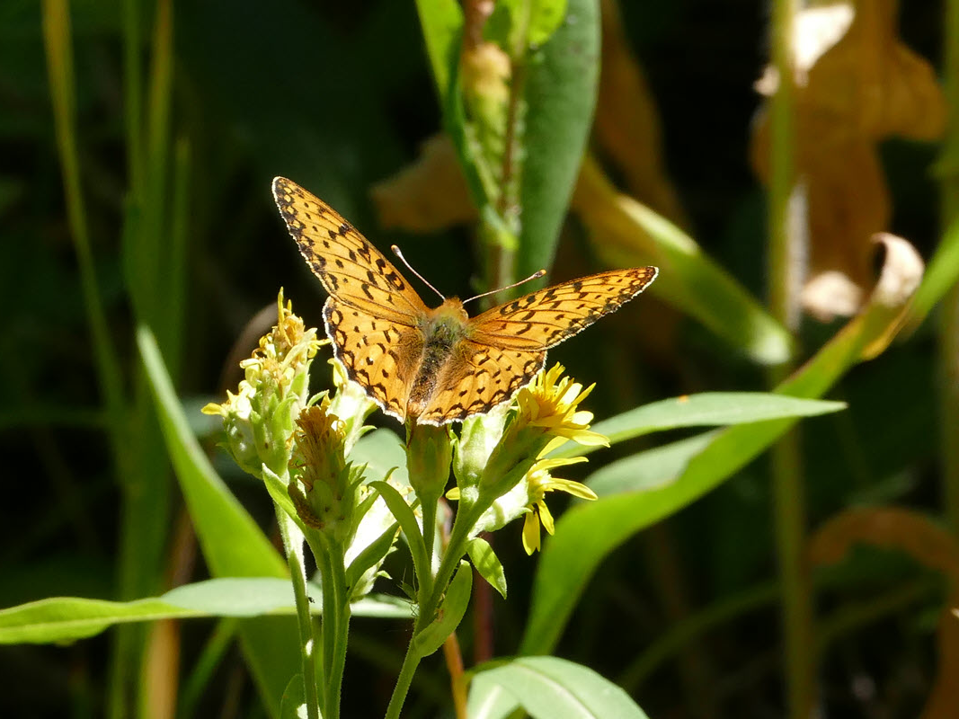
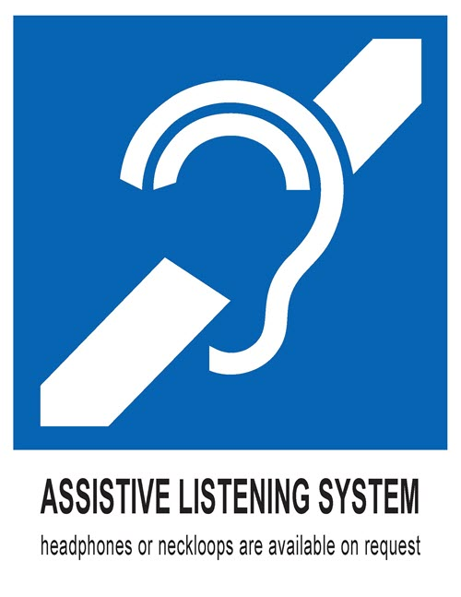
Welcome
To hear more clearly, ask to borrow headphones or neckloop at no cost (FM or infrared system)

Slide 2
Welcome

Slide 3
To hear more clearly, our theater/place of worship/library/etc. has an FM/infrared System
Select either FM or infrared
To borrow equipment at no cost, please visit (location)
For those with hearing aids and cochlear implants with telecoils
  Borrow neckloop and receiver
  Switch to your telecoil program
For those without hearing aids or without telecoils
  Borrow headphones and a receiver
(insert your logo)

