Slide 1
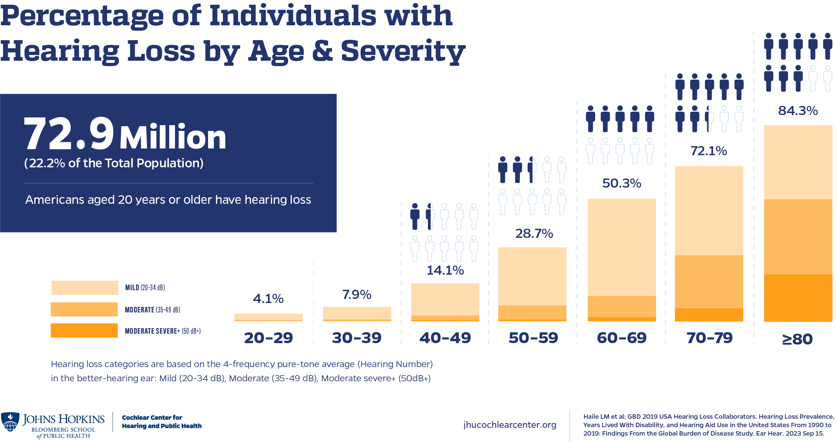
Hearing Loss Increases with Age
Add your logo
https://www.jhucochlearcenter.org/infographic-hearing-loss-prevalence-us
Approximately 870,000 to 1.16 M Coloradoans are deaf, hard of hearing, or deafblind (15-20%)
To communicate:
97.2% to 99% use oral communication
1% to 2.8% use sign language
Replace fuschia highlight with your state’s info

